Slide 1


组件化演变之路《react》
前后端分离从入门到脑残

Slide 2



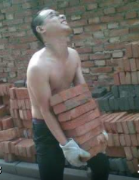
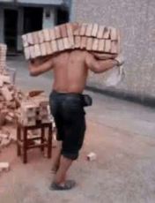
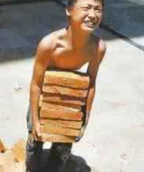
1963年
2002年
2017年
DIV+CSS
HTML5+bootstrap
REACT

Slide 3



分离
为何要做前后端分离，什么是真正的前后端分离？-全分离以及半分离工作模式
组件化
主流坑
如何让组件与组件之前不相互干扰？如何提高重用性？
为什么使用这些坑？什么是*.jsx，用这些坑可以干什么

Slide 4
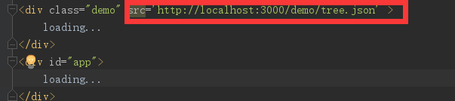
本地资源
全分离
半分离

Slide 5
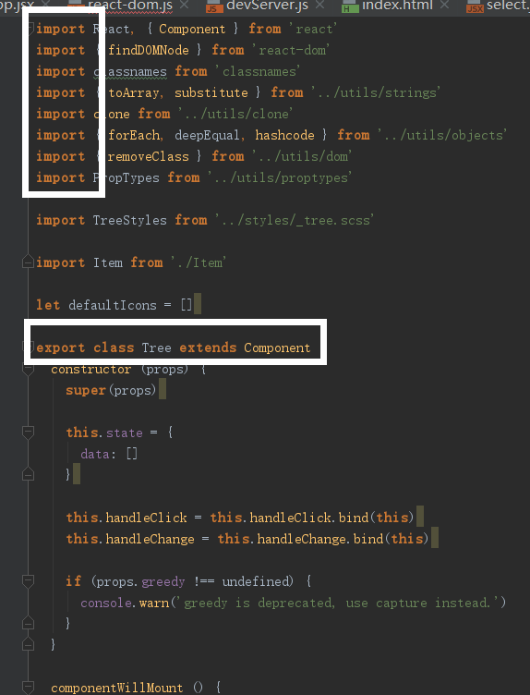
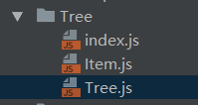
CLASS 袭来！

Slide 6
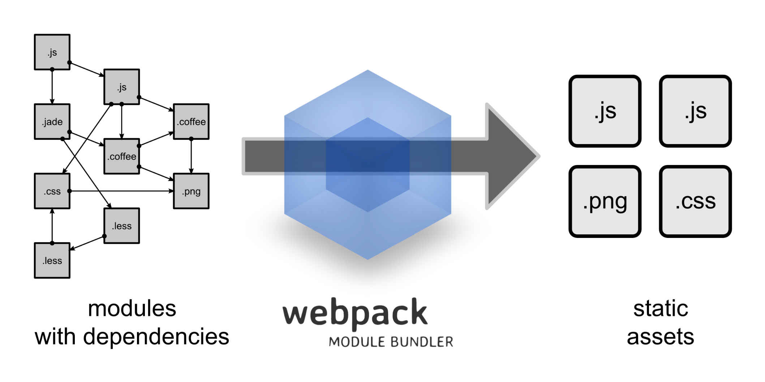
需要编译！

Slide 7


万什么梅
阿姨

Slide 8
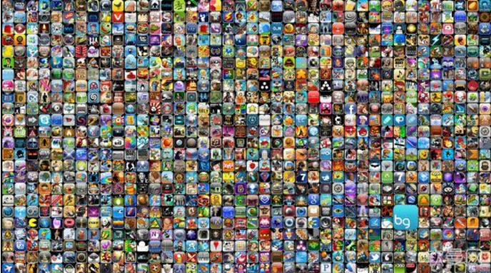
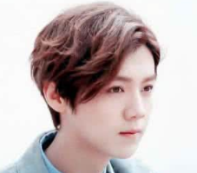
万什么梅
阿姨
神秘人物
十万个APP

Slide 9

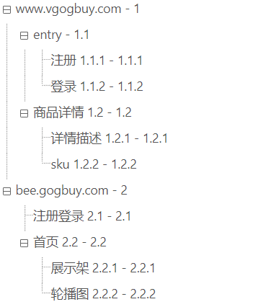




管理组件资源

Slide 10
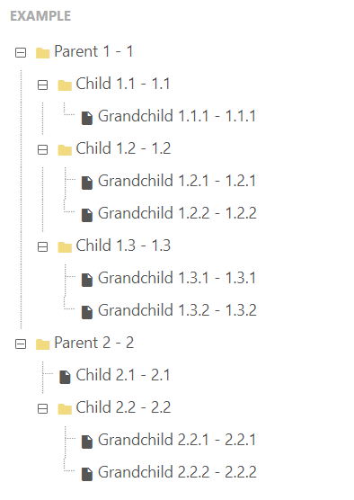
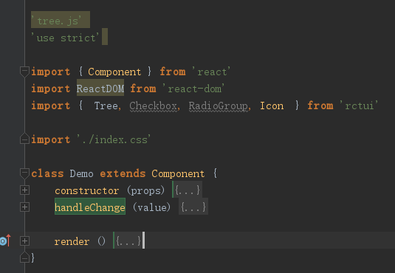
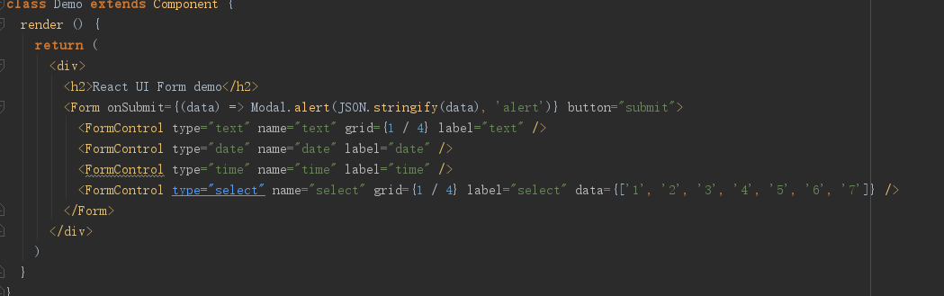
Render（）
初始化结构

Slide 11
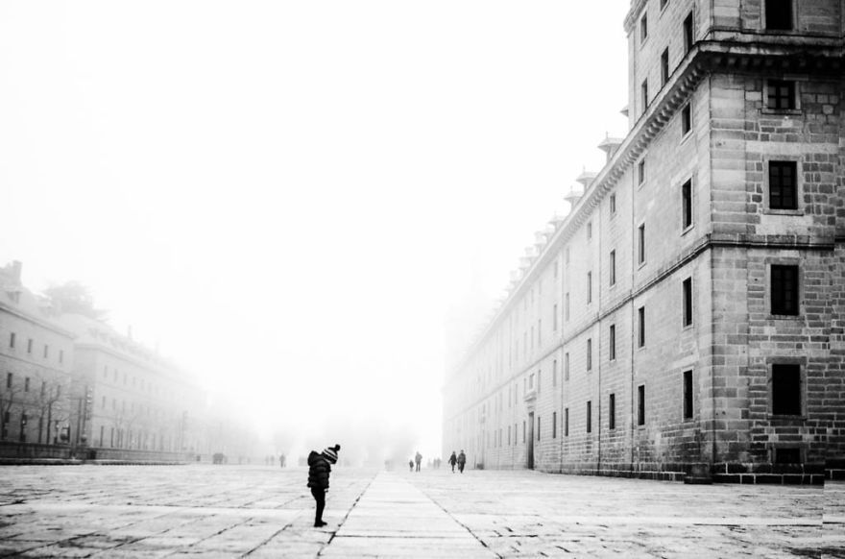

IN THE HEART
I to blow on the chaotic street in the wind to fondly remember happiness
I was thinking of in the familiar environment yesterday, I was recollecting joyfully nearby the vast sea
I was tasting sadly under the sob sky
HEART
I smiled in front of the mirror

Slide 12
THE CHOICE
so long as you will cross well I also can think happily So long as you are good I can good
Please remember certainly must cross is happier than me certainly wants
80
60
70
90
I KNEW
I KNEW
I KNEW
I KNEW
also does not trust me
otherwise you cannot listen
to others talking nonsense
also does not trust me
otherwise you cannot listen
to others talking nonsense
also does not trust me
otherwise you cannot listen
to others talking nonsense
also does not trust me
otherwise you cannot listen
to others talking nonsense

Slide 13
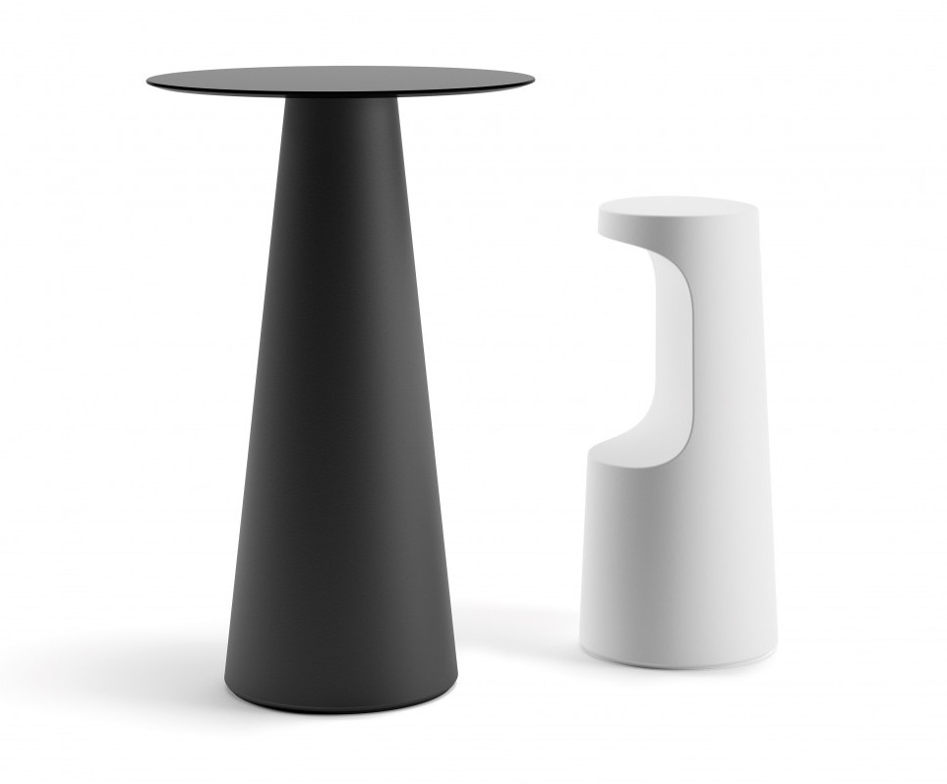
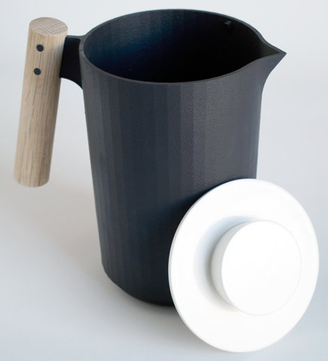
HURRY
I could not think you could think like this If did not
Have him to meddle we perhaps in together

Slide 14
THE CHOICE
so long as you will cross well I also can think happily So long as you are good I can good
Please remember certainly must cross is happier than me certainly wants
The dream
The dream
The dream
The dream
GRIEF
HURRY
SORROW

Slide 15



I KNEW IF SUCH GETS DOWN ALSO TO BE ABLE AGAIN TO BE
A MISTAKE EVENTUALLY
whose anyone arrives finally nobody to be able to be But believed is good I to awaken suddenly such has not sunk confuses Recently the code could not look like your same love to suffer extreme distress is even difficult to sleep all night not right

Slide 16

THE CHOICE
You said that you can respect me the choice From this time on you can not enter my world Then I said good we are respectively well
The dream
The dream
The dream
The dream
GRIEF
HURRY
SORROW

Slide 17
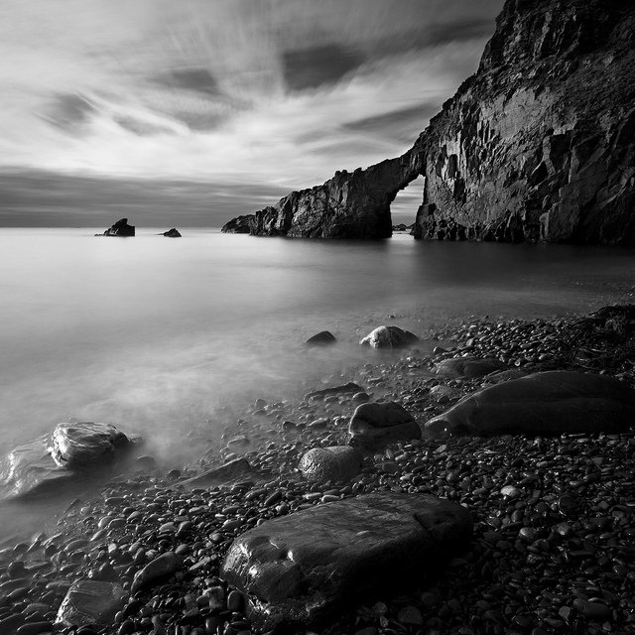
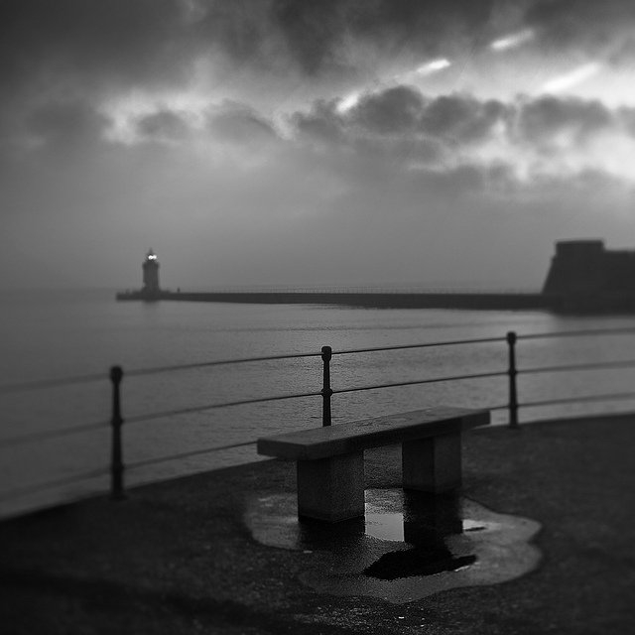
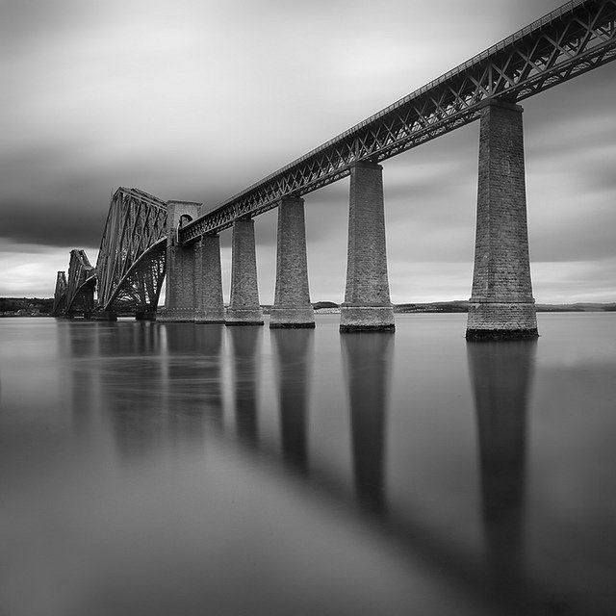

I KNEW
I KNEW
what significance like
this also has to you to me
Why province dessert
what significance like
this also has to you to me
Why province dessert
I KNEW
I KNEW
Faces the reality not to
have to pursue that not to have
the result question
what significance like
this also has to you to me
Why province dessert

Slide 18

Actually
you do not Understand me
also does not trust me
otherwise you cannot listen
to others talking nonsense
also does not trust me
otherwise you cannot listen to others talking nonsense
also does not trust me
otherwise you cannot listen
to others talking nonsense
also does not trust me
otherwise you cannot listen
to others talking nonsense

Slide 19

THE CHOICE
Therefore I hoped you might cross very much from now on happily will cross is better than me, so long as you have been happy
GRIEF
HURRY
SORROW

Slide 20
SORROW
I to blow on the chaotic street in the wind to fondly remember happiness
I was thinking of in the familiar environment yesterday, I was recollecting joyfully nearby the vast sea
I was tasting sadly under the sob sky

Slide 21
THE CHOICE
also does not trust me
otherwise you cannot listen
to others talking nonsense
also does not trust me
otherwise you cannot listen
to others talking nonsense
also does not trust me
otherwise you cannot listen
to others talking nonsense
also does not trust me
otherwise you cannot listen
to others talking nonsense

Slide 22

SORROW
You knew that was not the impossible matter you to believe eventually I was very disappointed to you I thought you could understand me

Slide 23

I KNEW IF SUCH GETS DOWN ALSO TO BE ABLE AGAIN TO BE
A MISTAKE EVENTUALLY
See you

